Slide 1




Elkins Cheer
2025-2026

Slide 2
Welcome
Coach DOMINY- HEAD COACH
7TH YEAR TEACHING AND COACHING AT ELKINS
Asst Coach - Lotanna Nneji
3rd year teaching and coaching at Elkins

Slide 3
Message from the district
The Board believes that student activities provide opportunities for students to practice and demonstrate the attributes of the Profile of a Graduate. As such, the District shall encourage participation in student activities, engage students through inclusive and collaborative experiences, and allow students the opportunity to create and participate in student organizations and student groups.This handbook becomes effective immediately for the tryout process in the current school year and remains in effect for successful candidates throughout the period until tryouts the following calendar year.

Slide 4
Profile of a Graduate
FBISD Athletics exists to inspire and equip student athletes with responsibility, values, sportsmanship, and teamwork through participation in sports so they can pursue futures beyond what they can imagine.
Cheerleaders will exhibit the FBISD Profile of a Graduate, including being a collaborative team member.

Slide 5
Important Dates
February 25- Stunt Clinic (optional) Elkins gym
March 3-4 Tryout Clinic 5:30-7:30 Elkins Gym
March 5 Mock Tryouts 5:30- 7:30 Elkins Gym
March 6 TRYOUTS 7PM Elkins Gym (candidates can start arriving at 6 PM
March 27 5:45 Parent meeting for new cheerleaders Room 122
April 3 4:30 fitting Room 122

Slide 6

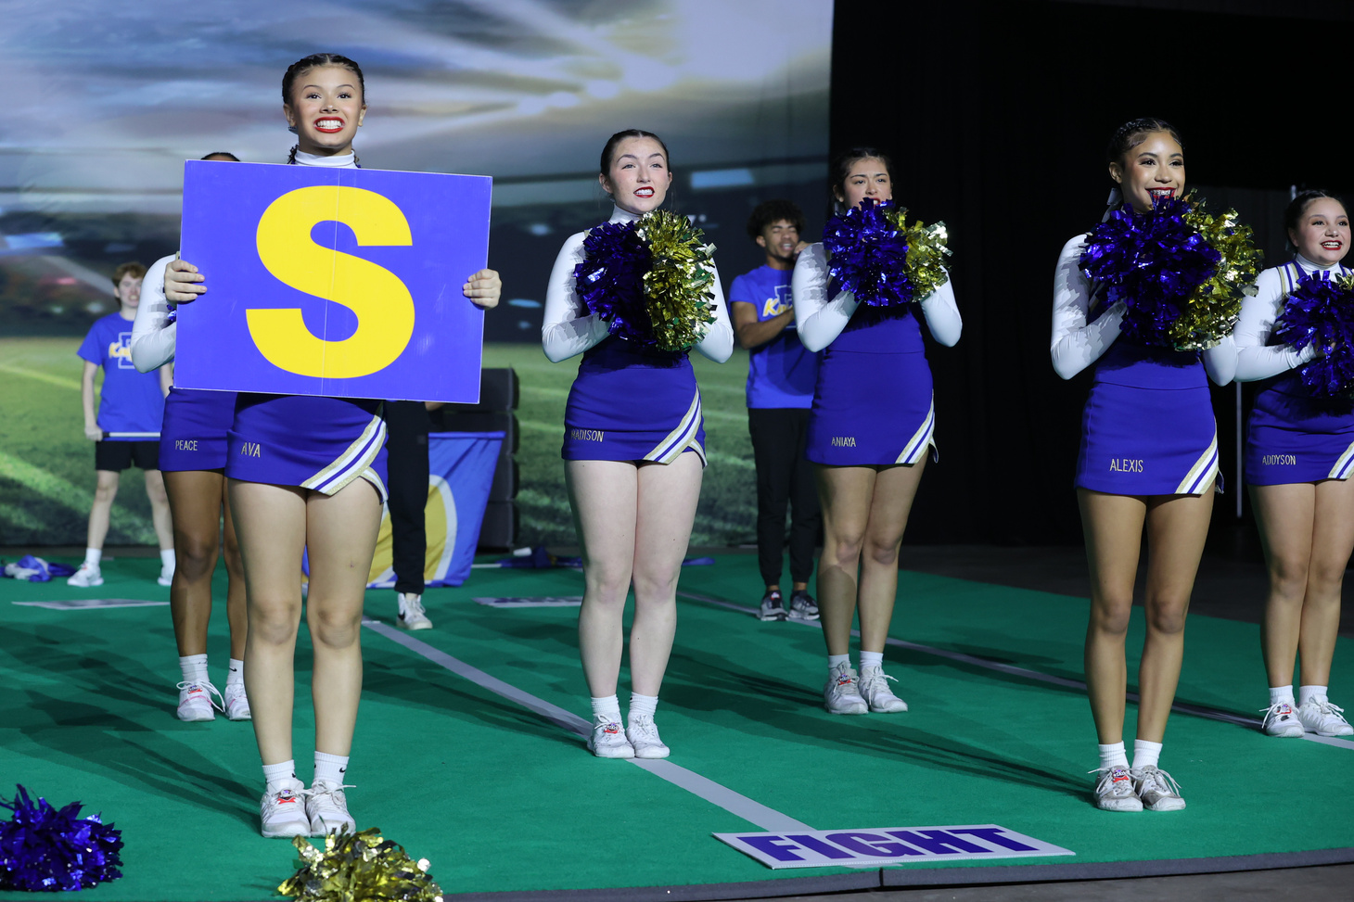
Expectations
*Student athlete behavior contract*
You are a 24/7 representative of EHS -On Campus/ Off Campus/ Social Media included!!!
Academics - Do not get behind, attend tutorials, be a leader in class
Understand that you are being watched by everyone at all times
Be in dress code
Social media can get you into trouble even if it is private

Slide 7
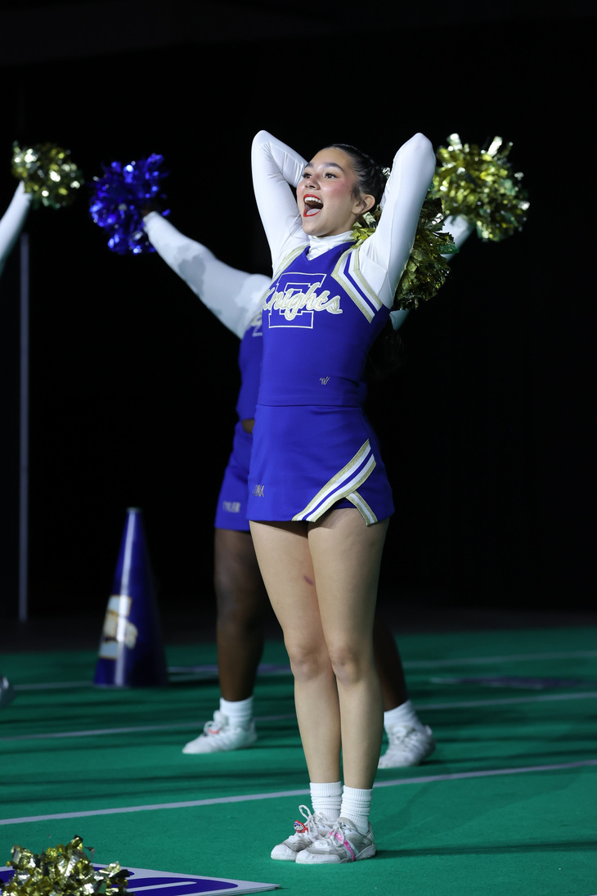
Composition of the Squad
Varsity:
· Squad of up to 16 cheerleaders
· Comprised of current freshman, sophomore, juniors, and eighth graders currently enrolled in the school’s feeder pattern or approved transfers such as academies
Junior Varsity:
· Squad of up to 16 cheerleaders
Comprised of current freshman, sophomore, juniors, and eighth graders currently enrolled in the school’s feeder pattern or approved transfers such as academies

Slide 8

Requirements to tryout
Academic Standing:
  · Meet and maintain University Interscholastic League and District academic eligibility standards.
  · Be on credit schedule to meet graduation requirements (2 1/2 - Freshman, 7 1/2 - Sophomore, 12 1/2 - Junior).
  · Must not have received more than two total failing grades on the first (T-1) and second (T-2) nine weeks grading reports for the current school year. Failing semester grades and failing grades in approved advanced placement classes for eligibility do not count against the allotted two failing grades. Current eighth graders must be academically eligible at the time of tryouts.

Slide 9
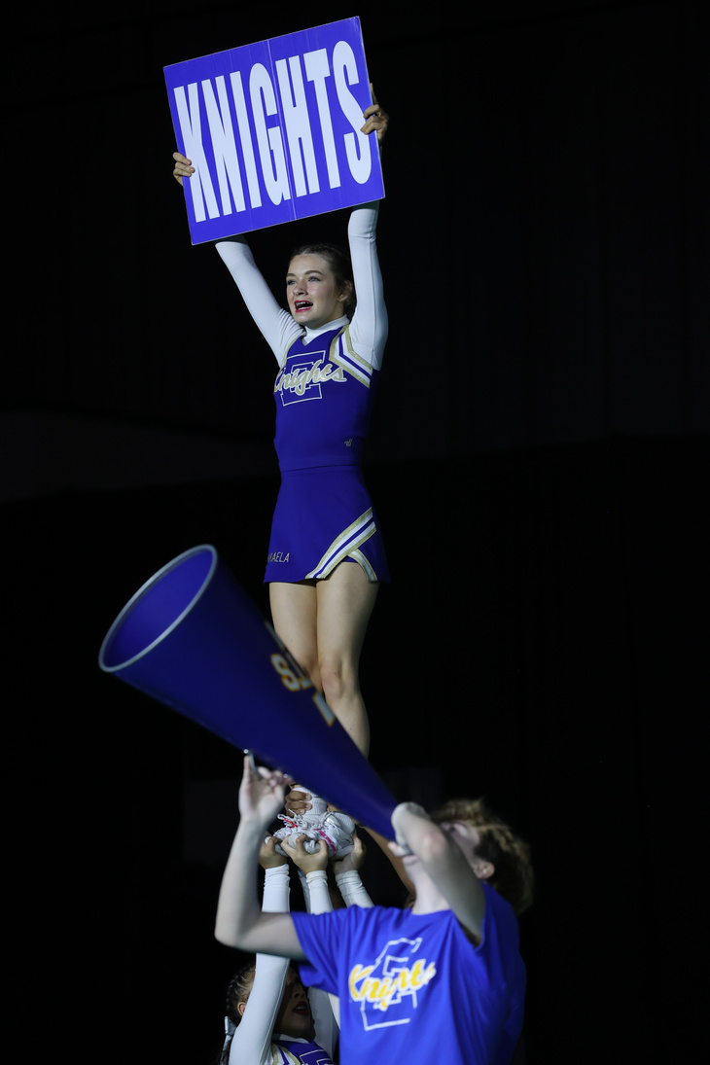
Requirements to tryout
Students must have good attendance.
School Behavior
Candidates may not have received any of the following during the school year
A “U” in the conduct category on any report card
More than one N (Needs Improvement) or any report card
Placement in OSS or ISS
Any level IV/V infraction
More than two Level II/Level III disciplinary infractions or a combination if thereof

Slide 10
Pre-tryout Clinic
MARCH 3-4
MARCH 5
Candidates should attend each day of the pre-tryout clinic to help them prepare for tryouts. Clinic details will be established by the campus. During the clinic, each campus will specify the activities to be performed at the tryouts
Mock tryouts
allows the cheerleaders to run through tryouts and to experience what the process will be like

Slide 11
Parent Meeting and Forms:
In order to be eligible for tryouts, each candidate and their parent/guardian must attend a mandatory meeting to discuss the selection process and cheerleader responsibilities.They must receive and sign for tryout packets. Any parent/guardian who is unable to attend this meeting must contact the cheer coach prior to the date of the meeting to receive the information for their student to be able to participate in the tryouts.
· MUST TURN IN PAPERWORK BY FIRST DAY OF CLINIC
-Parent Permission form -application
-Letter of intent - Administrative Seal of Approval -RankOne forms

Slide 12
Forms
Letter of Intent
Varsity Only- You only want to be on the varsity squad assuming you are in the top point earners
Both- You are okay with being on either team assuming
you are in the top 32
  Rank One Forms
Physical Examination: All candidates must submit a current preparticipation physical examination form signed and stamped by a medical doctor before the tryout clinic.
-athletic participation form
-emergency contact form
-UIL signature page

Slide 13
Tryouts
  Tryouts will take place on campus
  Tryouts are closed to the public
  At least 1 campus administrator AND co-coordinator
  Students must wear solid blue shorts and a solid white t-shirt, at tryouts they will pin their number to their shirt! (no logos or insignia of any kind)
  current Elkins cheerleaders may not signify in any way
  3 impartial judges
  jumps, tumbling, cheer, dance

Slide 14
Tryouts
Go to Handbook to give rubric and scoresheet example

Slide 15

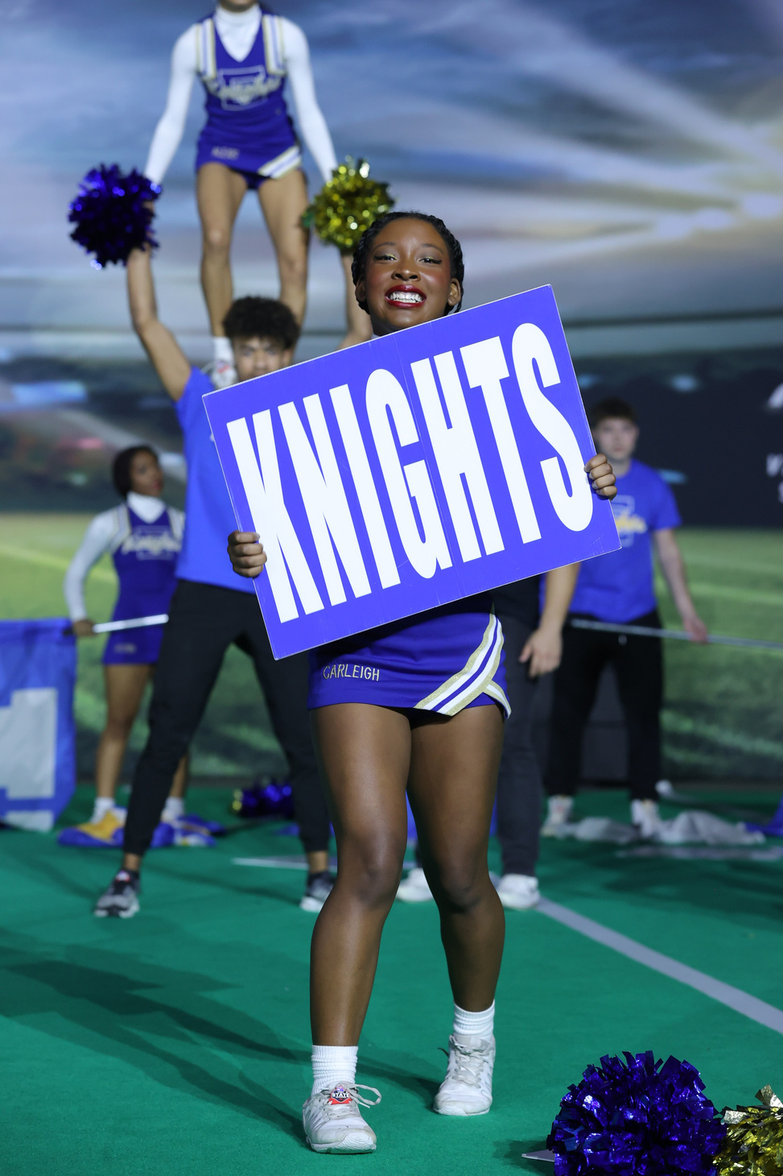
Results
· Each judge will score each candidate's performance using a numeric scale (exhibit B) and scores from each judge are tabulated to yield one total score for each candidate.
· Candidate's total scores are ranked in numerical order.
· Candidates with the highest rankings are selected as cheerleader according to cheerleader numbers specified at each campus. ( max. 16 and 16)

Slide 16
Results
The coaches and a principal designee will decide upon varsity/junior varsity team
placement of candidates. Candidates chosen for each team must come from the top point-earners from tryouts, but selection to varsity or junior varsity is done
irrespective of how candidates scored at tryouts.
Important: it is not a requirement that scores be included as a factor when deciding varsity/junior varsity placement.
There is no prescribed team size for schools who have fewer than the maximum 32
(ex.: a team could have 10 varsity members and 12 junior varsity or 16 varsity and 8
junior varsity members and so on).
Results will be released after the completion of tryouts on March 7th at 5 PM

Slide 17
Results
If the coach chooses to take the maximum number per team (16,16), then the coach will assign teams from the top 32 point-earners from tryouts
If the coach chooses to use the natural break for a given school which could be less than the district maximum of 32, the coach will assign teams according to those candidates who finished above the natural break that approximates a full team.
There is no prescribed team size for schools who have fewer than the maximum 32 at tryouts

Slide 18
Results
Due to federal privacy laws protecting student records, a student or parent may not view the evaluation forms of other participants.
Appeals of the cheerleading tryout process, including final results, must take place at the campus level. Grounds for appeal may be made in reference to mathematical calculations or procedural impropriety only. Appeals must occur within five (5) school days, and during school business hours once final results have been announced.
Appeals of results/decisions will be final at the campus level.

Slide 19
Captains
The process for selection of captains (leadership) on the cheer team is done STRICTLY at the discretion of the coach.
The process for leader/ captain selection is a campus-based decision that is NOT appealable above the campus- level
To be a varsity captain the athlete must have been on varsity for one school year.
There is a captain selection process through committee
JV captains are chosen solely by coaches.

Slide 20
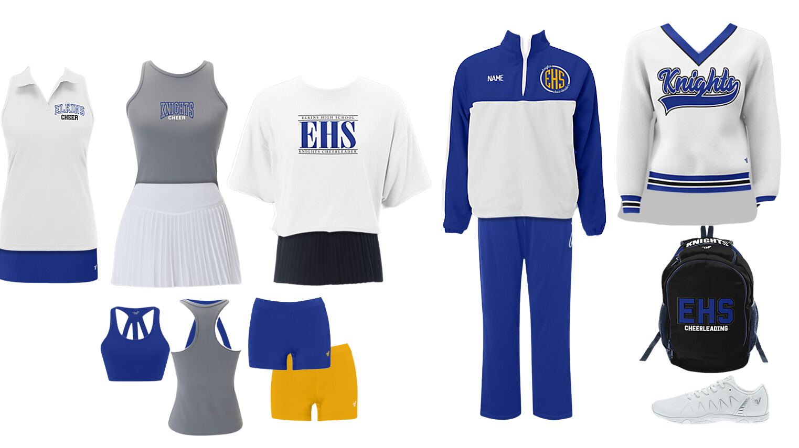
Style Story

Slide 21
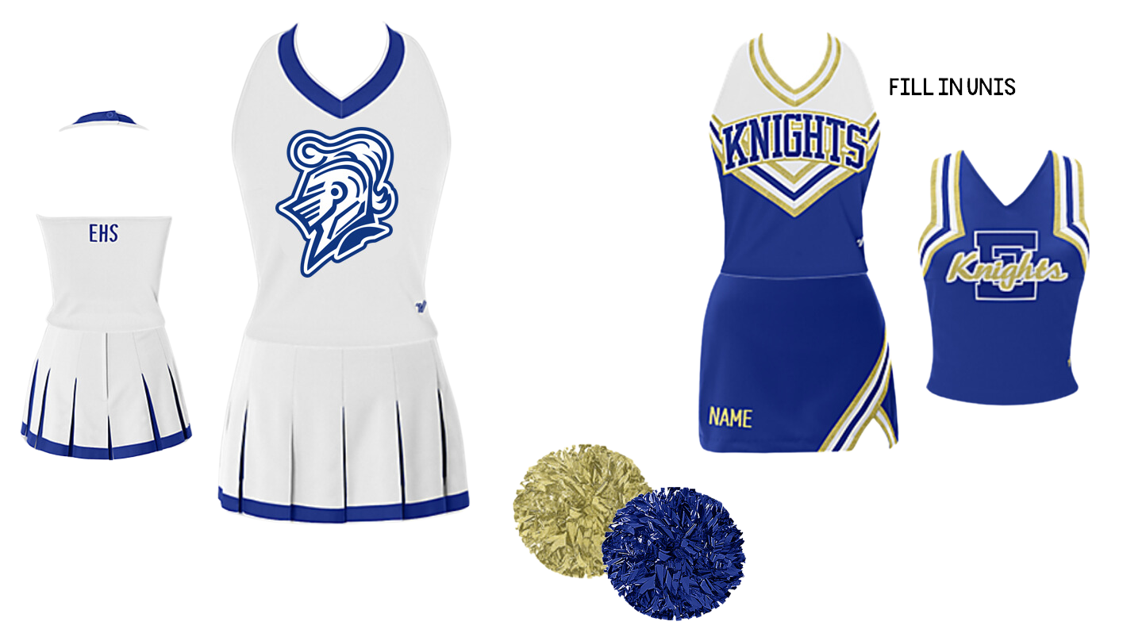
Style Story

Slide 22
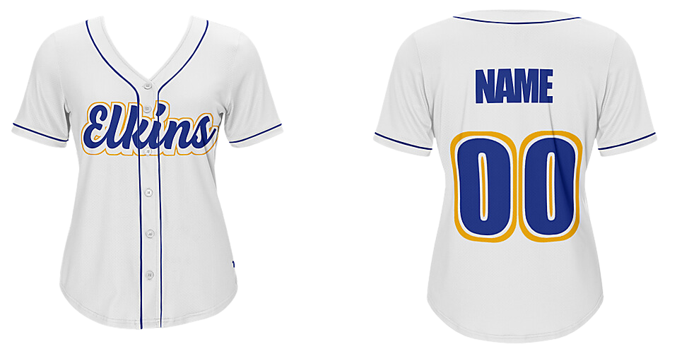
Style Story

Slide 23





Contact
832-316-4745
https://elkinscheer.weebly.com/
justine.dominy@fortbendisd.gov
7007 Knights Court

Slide 24
2025-2026
Questions?

